Slide 1
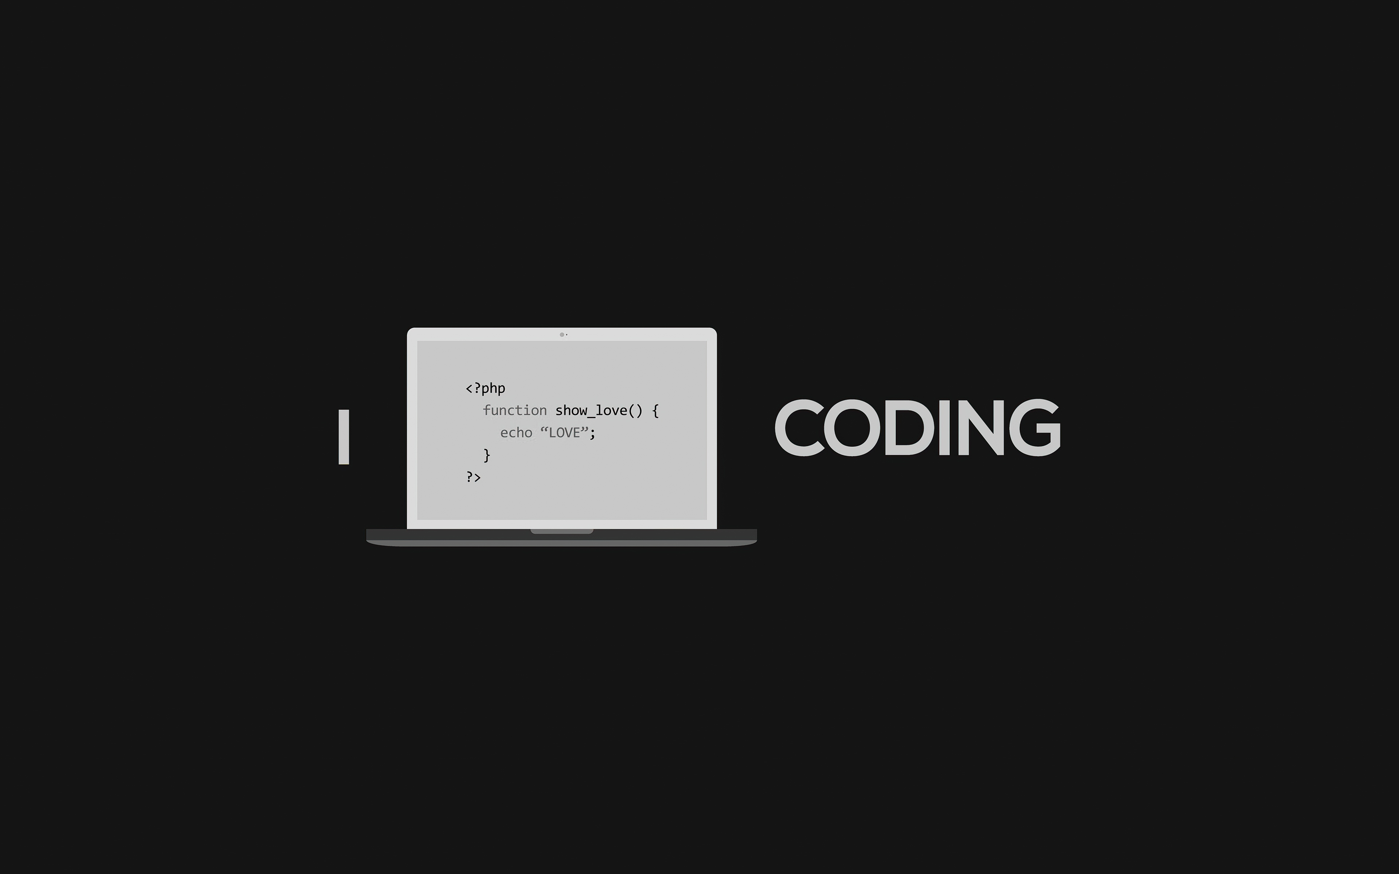
Vibe Coding with AI
Building a Simple Game from Prompts
Department of Math & Computer Science
Dr. Tianyu Wang
Notes:
"Good [morning/afternoon], committee members. Thank you for your time today. I'm here to present a proposal for a new course: CISC3XX - Applied Generative AI and LLM Applications.

Slide 2
Agenda
What is Vibe Coding
The Art of the Prompt
Design a Game: Classic Snake
Vibe Coding: Live Demo!
Workshop GitHub Repository:
https://github.com/tisage/game-llm/

Slide 3
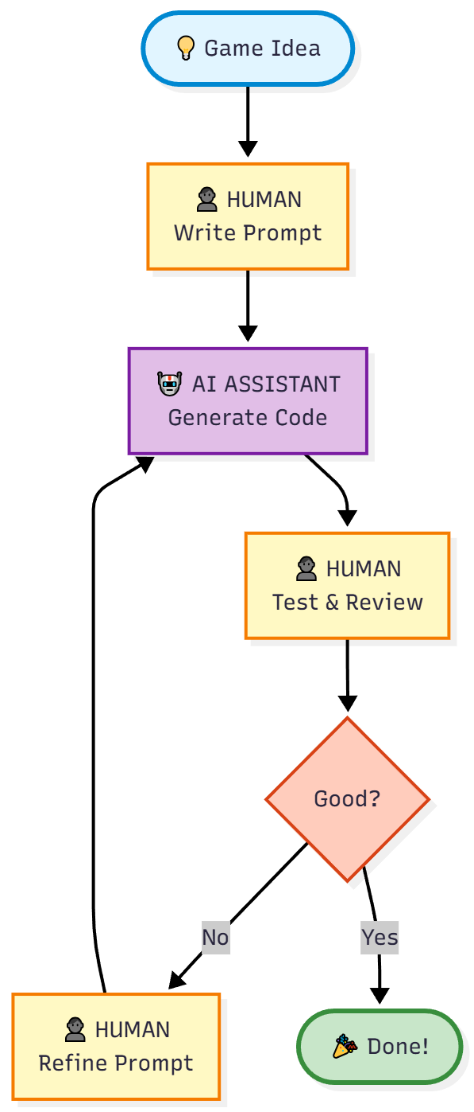
What is "Vibe Coding"
Vibe Coding: an AI-assisted software development practice where developers describe desired functionality in natural language, and an AI generates, refines, and debugs the code based on those prompts
Notes:
"Welcome, everyone! Today, we're going to talk about a fun and powerful way to create software called 'Vibe Coding.'"
It's a development style focused on rapid iteration and getting a feel for the end product as quickly as possible.
You act as the creative director, guiding an AI assistant (like Gemini or Copilot) to do the heavy lifting.
The goal isn't perfect code on the first try. It's about getting a functional prototype up and running, then refining it.
It's about capturing the "vibe" of your idea in code.

Slide 4
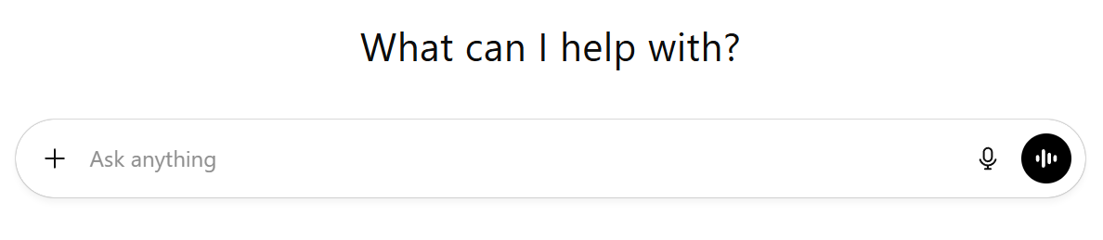
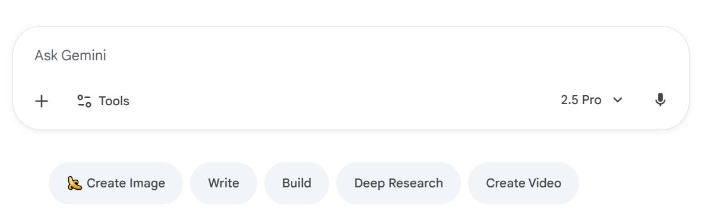
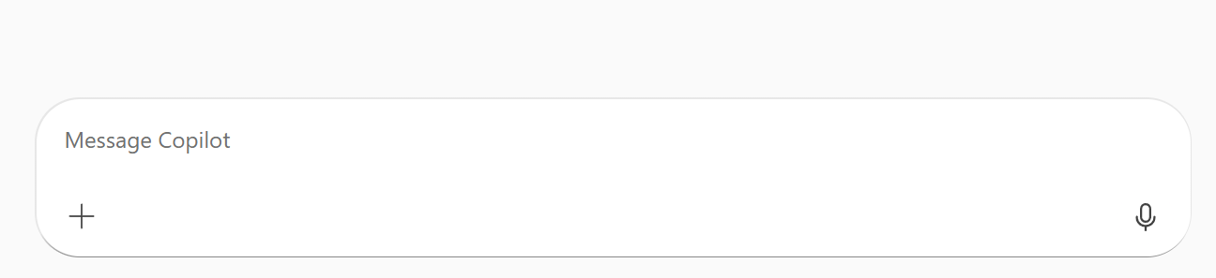
The Art of the Prompt
Prompt: A prompt is a user's input, such as a question, instruction, or command, given to an AI model to guide it in generating a specific response
Good prompts are:
Clear
Specific
Structured
Notes:
The most critical skill in vibe coding is communication. You need to tell your AI assistant exactly what you want. This is the art of the prompt."
Think of yourself as a Project Manager and the AI as your Developer.
Good prompts are:
Clear: No ambiguity.
Specific: Provide details (like colors, sizes, and numbers).
Structured: Organize your thoughts into logical sections.
A great prompt is like a great recipe. It ensures you get the result you expect.

Slide 5
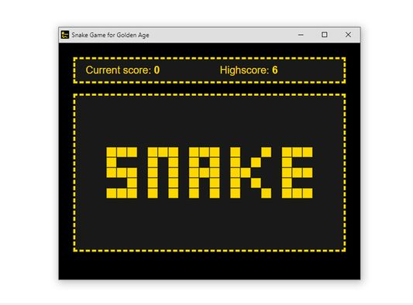
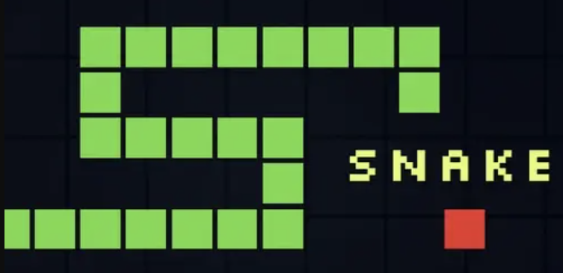
Design a Game: Classic Snake
Snake Game: Snake is a genre of action video games where the player maneuvers the end of a growing line, often themed as a snake. The player must keep the snake from colliding with both other obstacles and itself, which gets harder as the snake lengthens.
Notes:
"To put this into practice, we're going to design a complete game by writing a single, detailed prompt. Our example will be the classic Snake game."
We will break down our game design into five clear sections, just like a real design document.
This process will become the blueprint for our AI to follow.

Slide 6

Design a Game: Classic Snake
Prompt File Content
Purpose
What/How to Play
User Interface
Technical Implementation
Expected Delivery
Objective
Gameplay
UI
Implementation
Delivery
game_prompt.md
Notes:
"To put this into practice, we're going to design a complete game by writing a single, detailed prompt. Our example will be the classic Snake game."
We will break down our game design into five clear sections, just like a real design document.
This process will become the blueprint for our AI to follow.

Slide 7
Step 1: The Objective
Our Objective:
High-level goal
One-sentence summary of the project
## 1. Objective
Create a complete, single-file Python application for a classic Snake game using the Pygame library. The game should be easy to run and control, featuring a clean and visually appealing interface.
Notes:
Speaker Script: "First, we need a high-level goal. What are we building? This is the objective."
It's a simple, one-sentence summary of the project.
Our Objective:
Create a complete, single-file Python application for a classic Snake game using the Pygame library. The game should be easy to run and control, featuring a clean and visually appealing interface.

Slide 8
Step 2: Gameplay Mechanics
Game Board: The play area. (e.g., 800x600 window, 20x20 grid)
The Player (Snake): How does the player move and interact? (e.g., Starts in center, controlled by WASD, can't reverse).
The Goal (Food): What does the player try to achieve? (e.g., Randomly appearing food, snake grows when it eats).
Rules (Scoring & Game Over): How do you win or lose? (e.g., +10 points per food, game ends on collision).
Game Flow: How does the game state change? (e.g., Restart with 'R' key).
## 2. Core Gameplay Mechanics
* **Game Board:**
* The game should be played on a grid-based window.
* Window dimensions: 800x600 pixels.
* Grid size: 20x20 pixels.
* **Snake:**
* The snake starts in the center of the screen, moving horizontally.
* The snake is composed of square segments, fitting the grid.
* The snake's head should be a distinct color from its body.
* The snake continuously moves in its current direction.
* The player can change the snake's direction using WASD keys.
…
Notes:
Speaker Script: "This is the most important part. We need to define the rules of our game. How does it work?"
Game Board: The play area. (e.g., 800x600 window, 20x20 grid)
The Player (Snake): How does the player move and interact? (e.g., Starts in center, controlled by WASD, can't reverse).
The Goal (Food): What does the player try to achieve? (e.g., Randomly appearing food, snake grows when it eats).
Rules (Scoring & Game Over): How do you win or lose? (e.g., +10 points per food, game ends on collision).
Game Flow: How does the game state change? (e.g., Restart with 'R' key).

Slide 9
Step 3: GUI Design
User Interface (UI): What information does the player need? (e.g., Display the score in the top-left corner).
Graphics & Art Style: Define the aesthetic. Simple and clean is a great starting point. (e.g., Green snake, red food, black background).
Sound: Don't forget audio! For our example, we'll keep it simple. (e.g., No sound effects).
## 3. GUI
* **Graphics:**
* Use simple, clean, 2D graphics.
* The snake should be green, with a brighter green for the head.
* Food items should be visually distinct, with a 3D-like effect (e.g., a circle with a shadow and highlight).
* The background should be black.
* **User Interface (UI):**
* Display the current score in the top-left corner of the screen.
* Display the number of food items currently on the screen below the score.
Notes:
Speaker Script: "Next, let's think about the visuals. How should our game look and feel?"

Slide 10
Step 4: The Implementation Plan
Language and Library: Be explicit. (e.g., Use Python 3 and the pygame library).
Code Structure: This is key for good software engineering. We can ask the AI to follow best practices.
  Use a class to organize the code.
  Use constants for game parameters.
  Use separate methods for input, updates, and drawing.
## 4. Code Structure and Implementation
* **Language and Library:**
* Use Python 3.
* Use the `pygame` library.
* **Structure:**
* Organize the code within a `SnakeGame` class to encapsulate all game-related logic and data.
* Use constants for key game parameters like window dimensions, grid size, colors, etc.
* Create separate methods for handling user input, updating the game state, and rendering the game.
* Include a main game loop that controls the flow of the game.
…
Notes:
Speaker Script: "Here, we give technical instructions to our AI developer. We're telling it how to build the game."
Language and Library: Be explicit. (e.g., Use Python 3 and the pygame library).
Code Structure: This is key for good software engineering. We can ask the AI to follow best practices.
Use a class to organize the code.
Use constants for game parameters.
Use separate methods for input, updates, and drawing.

Slide 11
Step 5: The Deliverable
For a simple game, a single file is often best.
Our Deliverable:
## 5. Deliverable
A single Python file (`snake_game.py`) containing the complete, runnable game.
Notes:
Speaker Script: "Finally, what do we want at the end? We need to define the final output."
For a simple game, a single file is often best.
Our Deliverable:
A single Python file (snake_game.py) containing the complete, runnable game.

Slide 12
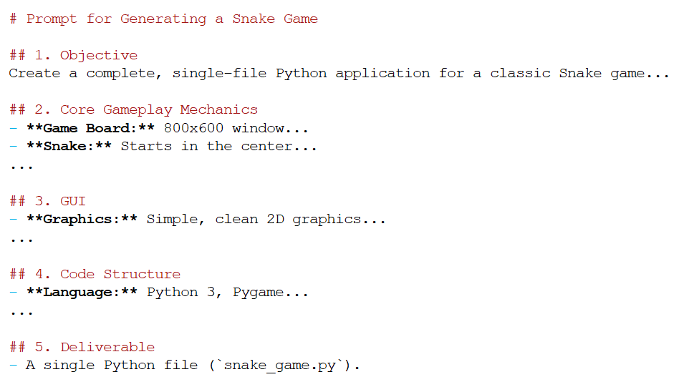
The Final Prompt
Final Prompt File
Notes:
Speaker Script: "Now, let's put it all together. This is the prompt we would give to our AI assistant."

Slide 13
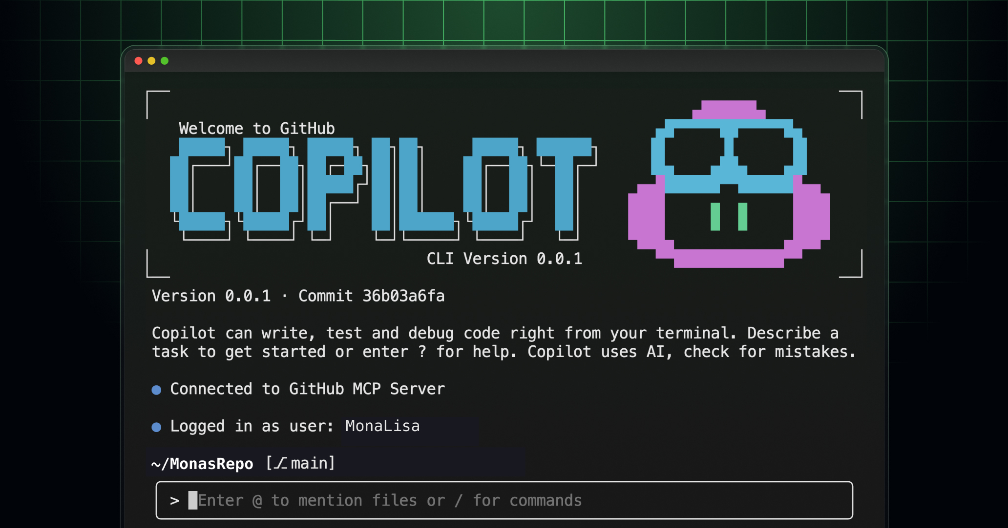
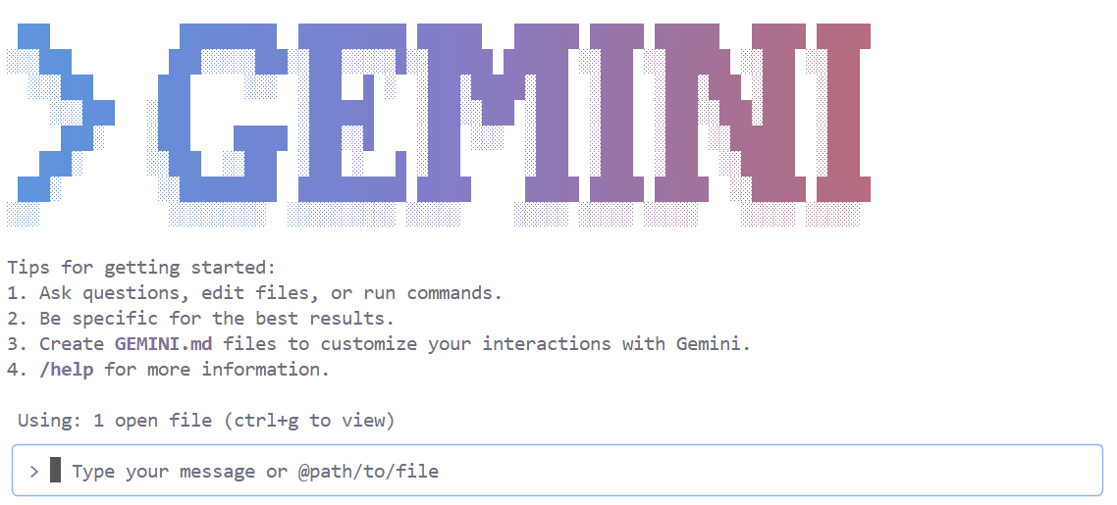
Vibe Coding: Live Demo!
Recommended AI CLI Tools for This Workshop:
  GitHub Copilot CLI - Free for students with GitHub Education
  Gemini CLI - Free tier available
Both tools work great for game prototyping. Choose whichever you prefer!

Slide 14
More Game Design Prompt Templates
More game prompts are available in /prompts/:
  game_design_prompt_snake.md - Classic Snake game
  game_design_prompt_pingpong.md - Two-player Pong game
  game_design_prompt_breakout.md - Brick breaker game
  game_design_prompt_flappybird.md - Flappy Bird style game
  game_design_prompt_spaceshooter.md - Vertical space shooter
  game_design_prompt_mazerunner.md - Maze navigation game
Each prompt includes: Objective, Gameplay Mechanics, GUI Design, Implementation Plan, and Deliverable
Workshop GitHub Repository:
https://github.com/tisage/game-llm/

Slide 15
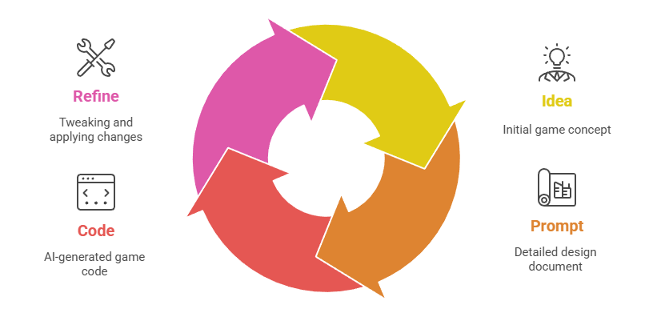
Recap
Idea: We had an idea for a game.
Prompt: We translated that idea into a detailed, structured design document.
Code: The AI generated the code based on our blueprint.
Refine: We can easily tweak the design and have the AI apply the changes.
Notes:
Common Questions:
What IDE works best for this workflow?
Any tips for writing better prompts?
How do I handle errors or bugs in generated code?
Can I use these prompts with other AI tools?
How do I get GitHub Education benefits for free Copilot?

Slide 16
Q & A
Thank You!
Workshop GitHub Repository:
https://github.com/tisage/game-llm/
Notes:
Q: How does this differ from CISC339? A: "CISC339 focuses on foundational AI algorithms and theory - how AI works internally. This course focuses on practical application - how to effectively use modern AI tools to solve real problems. Think of CISC339 as learning the mechanics of a car engine, while this course teaches you how to drive efficiently and safely."
Q: What if AI tools become outdated quickly? A: "That's exactly why we focus on principles and adaptability rather than specific tool versions. We teach prompt engineering techniques, ethical considerations, and evaluation skills that transfer across different AI platforms. The tools may evolve, but the underlying principles remain relevant."
Q: Is there enough student demand? A: "Absolutely. We see consistent interest in AI topics in CISC339, and students regularly ask about practical AI skills. The job market data strongly supports this demand, and this course provides exactly the applied skills that employers are seeking."
Q: What about academic integrity with AI tools? A: "This is a central part of the course. We teach responsible AI usage, proper attribution, and academic integrity explicitly. Students learn when AI assistance is appropriate and how to use it ethically, preparing them for professional environments where these tools are standard."
Q: Can students without strong programming backgrounds succeed? A: "The prerequisites ensure students have necessary programming foundation. However, the course is designed with scaffolded learning and template-based approaches that support students while challenging them to grow. The weekly lab format provides continuous support and feedback."

Slide 17
New Course CISC395 (Spring 2026)
New Course:
Applied Generative Artificial Intelligence and Large Language Model Applications
Elective Course: Special Topic
CISC395 CRN 15738, Spring 2026
Key Course Highlights:
  Practical Focus: Mastery of state-of-the-art tools.
  Core Skills: Prompt engineering, AI-assisted coding (vibe coding), and building Retrieval-Augmented Generation (RAG) systems.
  Hands-On Labs: Develop real-world applications using industry-standard tools like Google AI Studio, Copilot CLI, Streamlit, and Gradio.

